Slide 1
Welcome to Week 11

Slide 2

Correct Answer:
asdf=1
x= str(asdf)

Slide 3

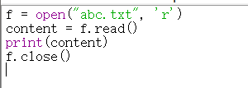
Correct Answer:

Slide 4

Correct Answer:
A = len (“str”)
B=abs(13)
Remember not to use str as a variable name because it is the name of a Python built-in function and will cause conflicts.

Slide 5


Correct Answer:

Slide 6
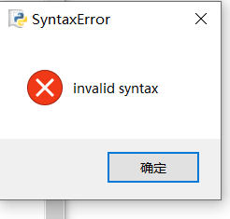

Slide 7

Error: range() step must be an integer, not a string.
Correction: x = list(range(1, 9, 1))[8].

Slide 8

Error: startswith() argument should be a string.
Correction: print(x.startswith("2")).

Slide 9

Error: Strings don’t have an append() method- add one item at the end to the existing list
Correction: Use a list: x = ['8’]; x.append(2)

Slide 10
Error: Attempting to index a value from the dictionary incorrectly.
Correction: {'1':'uno', 2:'dos'}[2]

Slide 11
Error: values() returns a dynamic dict_values object, which is not subscriptable.
Correction:
Convert to a list: list({"Mars":"War", "Neptune":"Sea"}.values())[1]
{"Mars": "War", "Neptune": "Sea"}.values()

Slide 12
Error: The number 2 is not in the list, so remove() fails.
Correction: num = [1, 3]; num.remove(1) or ensure the list includes 2

Slide 13
Error: index() expects a string '3'.
Correction: num = ('1', '3').index('3')

Slide 14
Error: '5' is a string, should be an integer.
Correction: letter = ("ha" * 5)[9].

Slide 15
Error: '0' is a string, should be an integer.
Correction: s = ['s', 'e', 'd'][0]

Slide 16
Error: Sets are unordered and don’t support indexing.
Correction: Use a list or tuple: x = [1, 2, 3][1]

Slide 17
Error: Tuples are immutable and don’t have an insert() method.
Correction: Use a list: x = [2, 3, 1]; x.insert(0, 0)

Slide 18
Error: eval() cannot handle assignment expressions.
Correction: x = 3 * 3 or num = eval('3 * 3')

Slide 19
Error: min() returns a single value, not subscriptable.
Correction: value = min([1, ord('a')]) to ensure consistent types.
ord() return the ASCII code of a.

Slide 20
19
Error: del with nested indexing is incorrect.
Correction: Define a list first, then delete, e.g., lst = ['11', '12', '13']; del lst[0].
20
Error: This expression is technically correct but outputs False.
Correction: Use print([2] in {1: [2], 2: [3], 3: [1]}.values()).
["air", "fire", "earth", "water"].sort()[2]

Slide 21
Error: sort() sorts in place and returns None.
Correction: lst = ["air", "fire", "earth", "water"]; lst.sort(); print(lst[2]).
22
Error: find() argument should be a string.
Correction: "1, 2, 3".find('1').

Slide 22
Notes:
skip

Slide 23
Notes:
skip

Slide 24
Try and Except
In Python, try and except are used for exception handling. They help you catch and handle errors that occur during code execution, preventing the program from crashing due to an error.
Basic Syntax
try:
# Code that might raise an exception
except SomeException:
# Code to handle the exception

Slide 25
Common Python Exceptions
ValueError: Raised when a function receives an argument of the right type but an inappropriate value (e.g., converting a non-integer string to an integer).
TypeError: Raised when an operation or function is applied to an object of an inappropriate type (e.g., adding a string and an integer).
ZeroDivisionError: Raised when attempting to divide by zero.
IndexError: Raised when trying to access an index that is out of the range of a list or other indexed collection.
KeyError: Raised when trying to access a dictionary key that does not exist.
FileNotFoundError: Raised when trying to open a file that does not exist.

Slide 26
Common Python Exceptions
AttributeError: Raised when an attribute reference or assignment fails (e.g., calling a non-existent method on an object).
ImportError: Raised when an import statement fails to import a module.
StopIteration: Raised to signal the end of an iterator’s items (e.g., using next() on an exhausted iterator).
RuntimeError: A generic error raised when an error doesn’t fall under any specific category (often used in libraries or custom error cases).
NameError: Raised when a local or global name is not found (e.g., accessing a variable that hasn’t been defined).
IndentationError: Raised when there is an error in indentation, such as mixing spaces and tabs (usually caught during code compilation).

Slide 27
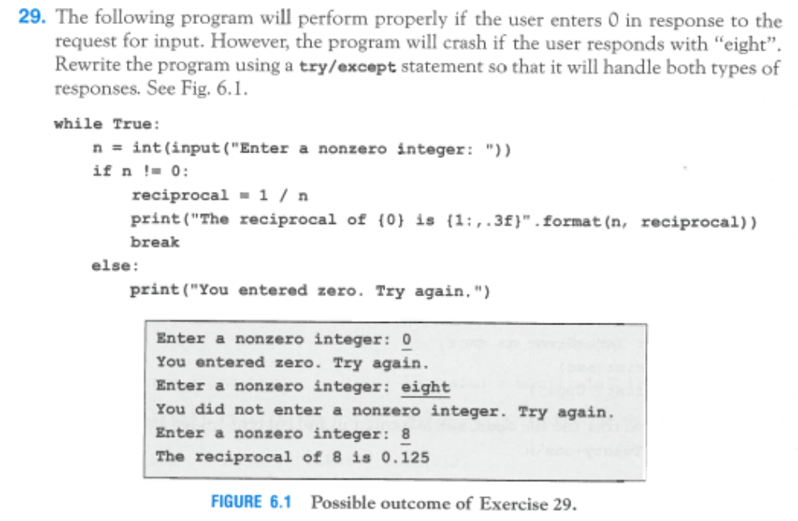

Slide 28
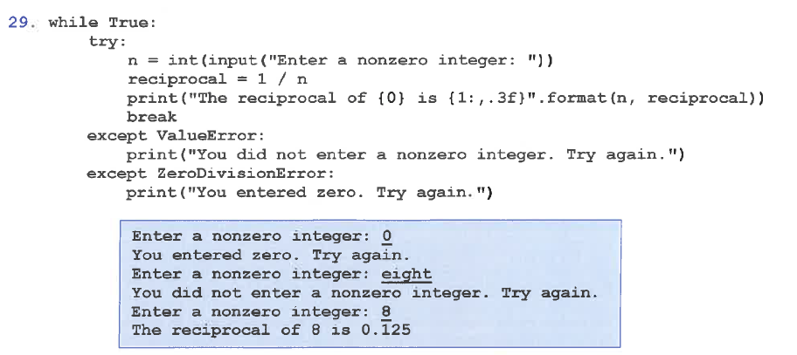

Slide 29
Part 2 TEST
Give each test a unique description. No two tests should have the same description and avoid numbers in your descriptions. Note that the number of rows in the table below is no indication on how many tests you should have. You may need more, you may need fewer. You must first work out the equivalence partitions, then type of data the program works with (ordinal vs. non-ordinal), then the boundaries and special cases, before you start filling in the table with the actual tests.

Slide 30
Movie tickets cost $5 for a child (<10 years of age), $10 for a teenager (10yr ≤ age < 20yr) and $12 for an adult (≥ 20yr).

Slide 31
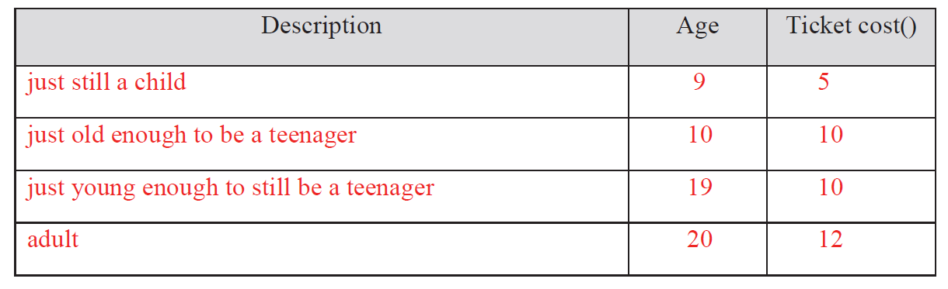
Boundaries
Boundaries
-------------10 ----------20(NOT INCLUDED)-----------

Slide 32
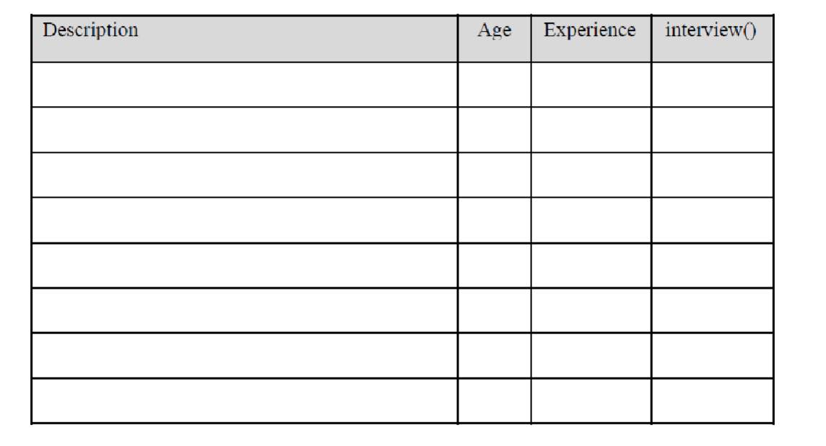
A company has a recruiting policy of only interviewing applicants between 25 and 40 inclusive. However, they will interview applicants up to the age of 45 if they have at least 10 years’ experience.

Slide 33
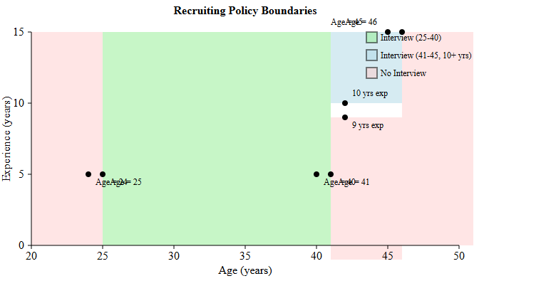

Slide 34
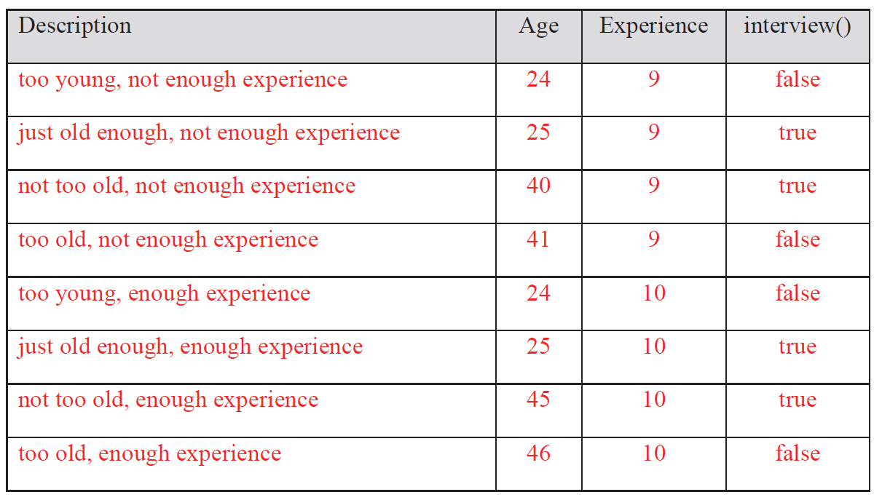

Slide 35
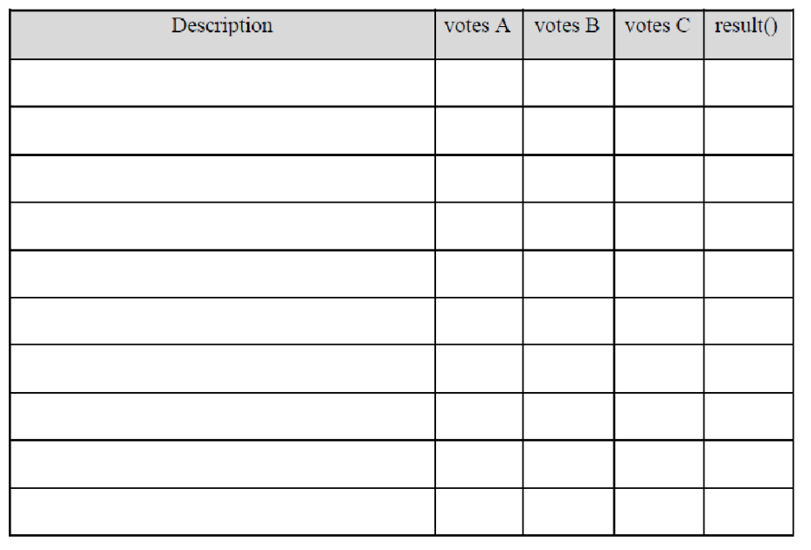
To be elected, a candidate must get over half of the votes cast. An election has 3 candidates, A, B, and C. If no candidate gets over half of the votes, the result is “-”. The input here is the actual number of votes, not percentages.

Slide 36
First, let's understand the requirements:
There are 3 candidates: A, B, and C
To win, a candidate must get over half (>50%) of total votes cast
If no candidate gets over half, the result is "-"
Input is the actual number of votes (not percentages)

Slide 37
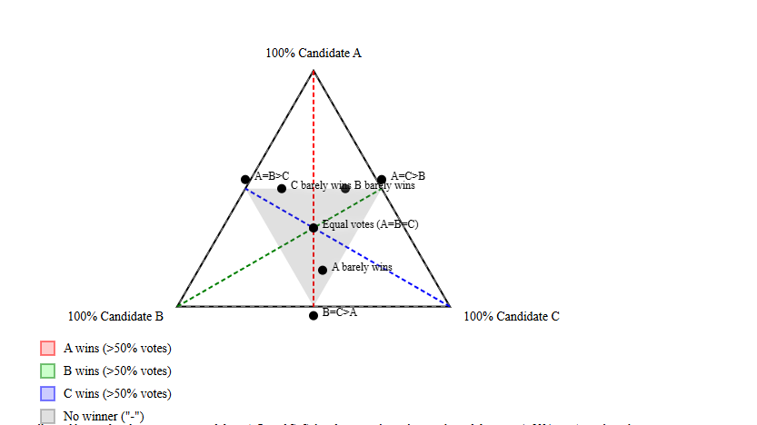

Slide 38
